Slide 1


Membership Overview
Supporting IP Professionals
Fostering Innovation & Creativity
Promoting an Effective & Balanced IP System

Slide 2
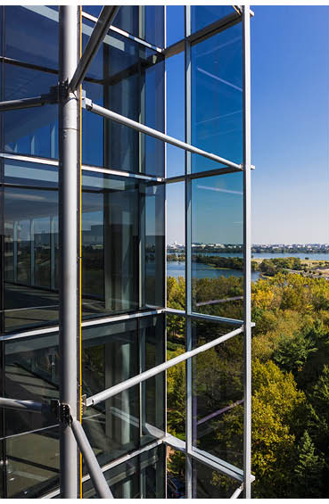
Formed in 1897
Voluntary bar association of Individual members:
  U.S. and International lawyers
  (in-house, private practice, government, academia)
  U.S. and International patent and trademark agents
  USPTO and other government professionals
  IP Academia and law students
  Other IP professionals
All forms of Intellectual Property
Headquarters in Arlington, Virginia (D.C. area)
Notes:
Formed in 1897 – 2022 is our 125th anniversary!
Voluntary bar association
Individual members:
U.S. and International lawyers (in-house, private practice, government, academia)
U.S. and International patent and trademark agents
USPTO and other government professionals
IP Law Professors and law students
Other IP professionals
All forms of Intellectual Property
Headquarters in Arlington, Virginia (D.C. area)

Slide 3
What can AIPLA do for you?
We enable our members to achieve their
full potential by providing:
Substantive Training
Career Development
Leadership Development
Network/Client Development
Supporting Policy and Advocacy Work
in the US and Internationally

Slide 4
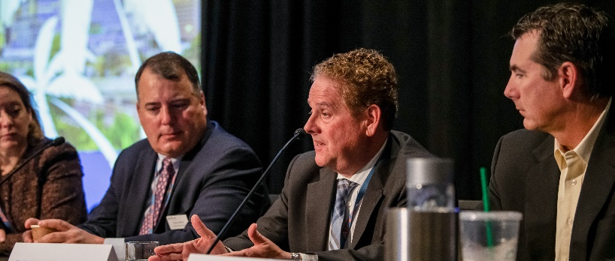


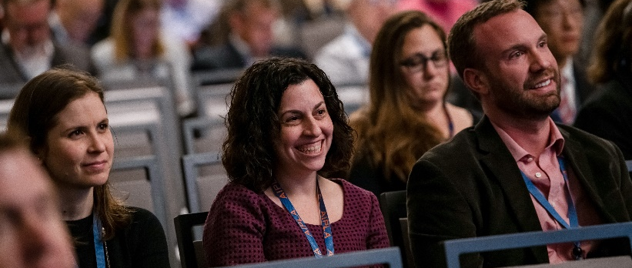
Substantive Training
The Standard for IP Focused CLE and Education
Stated Meetings
Online Programs
Online Library
Road Shows
Notes:
We are known for our industry leading, IP focused CLE and professional development opportunities. We have a robust schedule of professional development and CLE opportunities both in person and online.
We offer training at any career level and provide cross training opportunities at every level.
We offer diverse subject matter expertise
Our committee structure lets you follow-up with experts in the field.
Stated Meetings:
Our 3 annual stated meetings provide opportunities to get inspired by the brightest, most innovative IP leaders in the world. We also offer unique opportunities like our programs that bring in Judges from the Federal Circuit, US District Courts, the PTAB an TTAB.
Online programming: We offer 2 live webinars a month as well as an extensive archive of on-demand recordings. All of our webinars are free to members. Pay only for CLE processing.
We offer an All Access Pass for $495 that provides unlimited access to CLE as well as a 20% discount on stated meeting registrations
We have stand-alone educational programs around the country each year. Given the pandemic, some of these have been shifted to online learning series that take place over the course of a few weeks, and include post session informal discussions with the speakers:
The Electronic & Computer Patent Law Summit
The Trade Secret Summit Series
The Design Rights Boot Camp
Patent Prosecution Boot Camp
Trademark Boot Camp
PCT Roadshow
We also have an Online Library of Meeting Materials that contain papers and slides from past Stated Meetings. All in a searchable database!

Slide 5
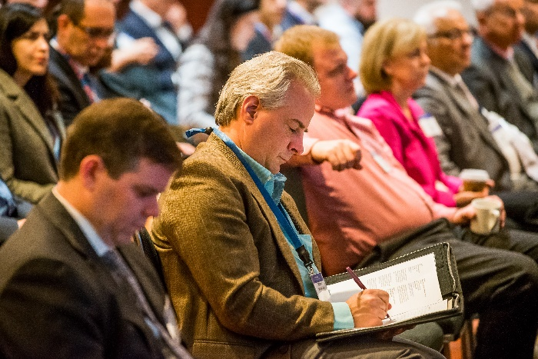
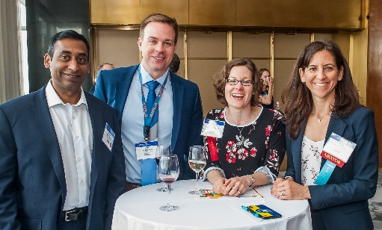

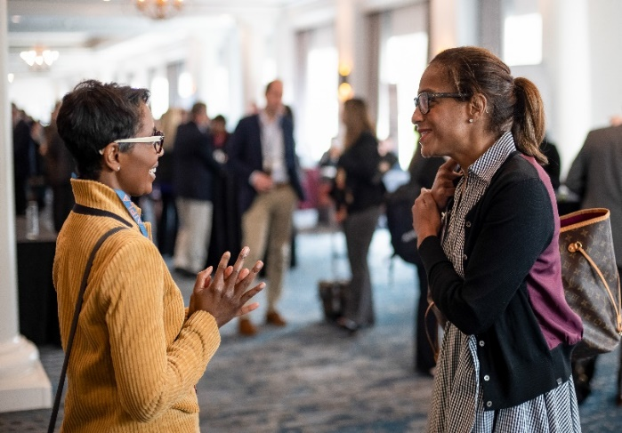
Career Development
Support at Every Stage
Regardless of the career stage you are in, we have programming and opportunities to help you manage career transitions, build your brand, and propel your career forward.
Notes:
Regardless of the career stage you are in, we have programming and mentorship opportunities to help you manage career transitions and propel your career forward - from student to associate to partner to a solo-practice.
There is an abundance of opportunities to build your name and propel your career through our committee structure. Committee activities allow you to build your professional network through participation. The connections you form at the committee level foster personal connections with leaders in the field that can provide a sounding board for you in your career. We also offer mentoring opportunities at meetings, and in mentoring groups – plus our new student mentorship program.
We provide opportunities to get published in many ways from editing papers, to INNOVATE and The Quarterly Journal.
Our Career Center is the place to go for those looking for their next challenge.
We have a variety of Law Student opportunities from our distinguished Giles Sutherland Rich Moot Court Competition, to writing competitions and academic awards.
Moot Court has 5 regional competitions and the top 2 from each region go on to the National Competition.
Jan Jancin Competition – for academic excellence in the study of IP law. = $5,000 award plus travel expenses to attend our Annual Meeting to receive the award.
Maurice Klitzman Award gets full travel expenses and Annual meeting registration

Slide 6
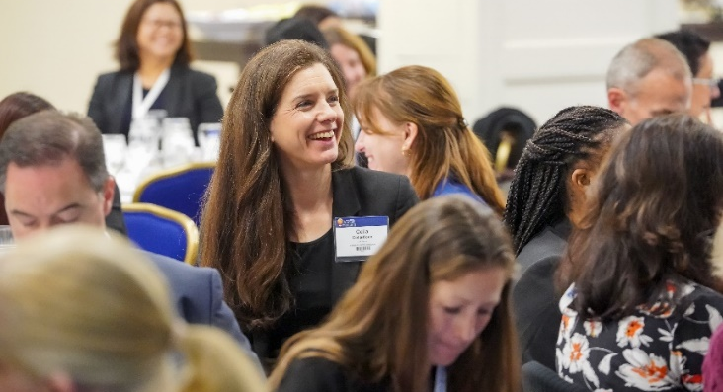
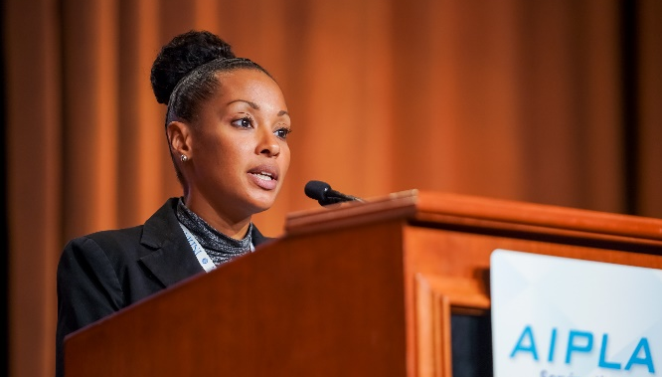
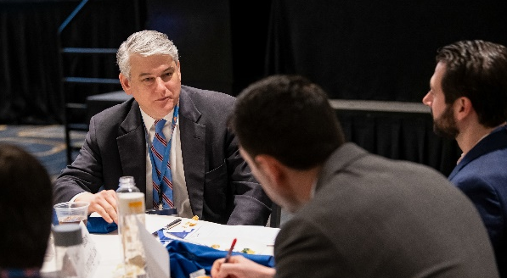
Leadership Development
Advancement Through Involvement
Our robust committee structure provides merit-based opportunities for leadership growth including project management, presentations, coaching, time management and public speaking.
Notes:
Committee work provides opportunities for leadership skill building in the areas of project development, program management, public speaking, writing skills, getting published and leadership development through mentoring.
There is no fees to join a committee and no requirement to participate as a non-voting member. You can join and leave at any time. You can become a voting member of a committee each fall during Open Season.

Slide 7
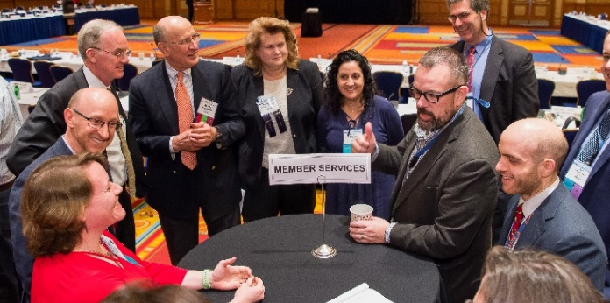


AIPLA Committees
The heartbeat of our organization
IP Prosecution and Litigation
Corporate
Regulatory
Notes:
We have over 60 committees so you are sure to find your “people” and your purpose in these small groups. There are tons of opportunities, resources, and benefits offered at the committee level that you wouldn’t be aware of if you weren’t on the committee. Committess offer everything from IP templates, to brown-bag lunches, to local meet-ups, to book clubs and networking events.

Slide 8
Committees
ADR
Anti-Counterfeiting & Anti-Piracy
Copyright Law
Industrial Designs
International Trade Commission
Trademark Internet
Trademark Law
Patent Law
Patent Litigation
PTAB Trial
Trademark Litigation
Trade Secrets
IP Prosecution and Litigation

Slide 9
Committees
Corporate Practice
IP Transactions
Mergers & Acquisitions
Standards & Open Source
Corporate

Slide 10
Committees
Antitrust
Food & Drug
Public Appointments
Regulatory

Slide 11
Committees
Committee on the Profession
Diversity in IP Law
Member Services
Online Programs
Public Education
Professional Programs
Women in IP Law
Law Practice Management
Service and Education

Slide 12
Committees
IP Practice in China
IP Practice in Europe
IP Practice in Israel
IP Practice in Japan
IP Practice in Latin America
IP Practice in the Far East
International & Foreign Law
PCT Issues
International

Slide 13
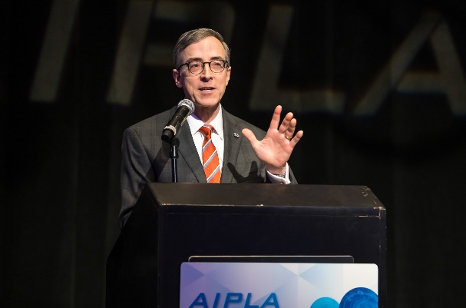
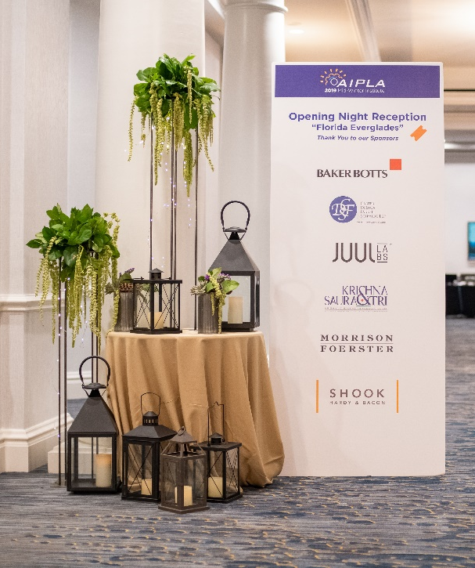
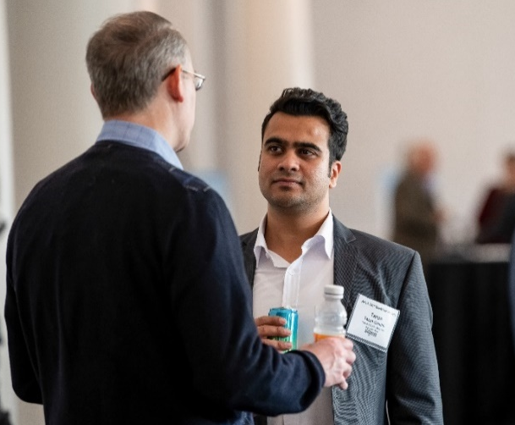
Client Development
Tools for Building Business
Participation in AIPLA provides avenues for increasing a firm’s visibility and highlighting expertise to the people that matter the most.
Notes:
Avenues include increasing visibility through sponsorships, highlighting areas of expertise through speaking, increasing awareness and your network through committee work and engagement.

Slide 14
How to Get Involved
Join Us
Go to www.aipla.org:
  Join online or
  Download an application, and
      Fax | +1.703.415.0786
      Email | membership@aipla.org
      Mail | AIPLA, 1400 Crystal Drive, Suite 600, Arlington, VA 22202
Questions: Call us at +1.703.415.0780 or email us at membership@aipla.org.
Notes:
Joining is easy and we offer convenient group billing options for firms that provides a single invoice and a discount for multiple members.

