Slide 1

Serving the Creative and Legal Communities
AIPLA/USPTO Women Entrepreneur Mentoring Program
Copyright and Trademark
March 20, 2024
Notes:
My name is Kelu Sullivan,

Slide 3





Trademarks and Your Business
Kelu L. Sullivan
Partner
Stephanie H. Bald
Partner
kelly-ip.com

Slide 4

What is a Trademark?
A brand new world
A word, phrase, symbol or design that identifies a product or service as originating from a particular source.

Slide 5



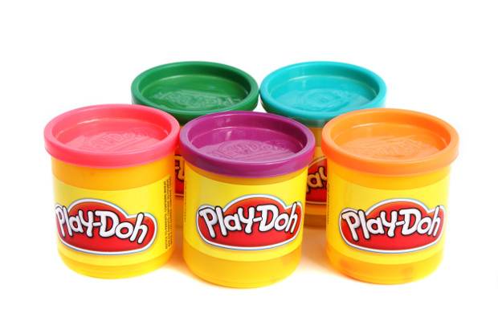
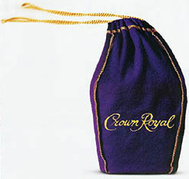
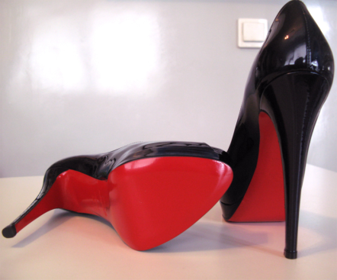
Examples of Trademarks
A brand new world
Word
Symbol
Sound
Phrase
Scent
Product Design/Packaging
Color
I’M LOVIN’ IT

Slide 6
Trademark v. Corporate Name v. DBA
A brand new world
Type | Purpose | Example
Trademark | Identifies the source of the product/service Federal registration through USPTO or common law rights through use | FACEBOOK
Corporate Name | Legal name filed through state Secretary of State by incorporating a legal entity | Meta Platforms, Inc.
DBA | Legal alias of a business | META

Slide 7
How to Protect a Trademark?
A brand new world
Select a distinctive trademark
Conduct a trademark clearance search
File a trademark application
Use the mark
Maintain federal trademark registration
Enforce against generic uses and/or third-party infringements

Slide 8
How to Enforce Your Trademark Rights
A brand new world
Monitor third-party uses on the Internet, social media, competitor websites
Monitor new trademark applications submitted to the USPTO
Consider the options:
    Cease-and-Desist Letter
    Takedown Notices
    Domain Disputes
    Letters of Protest
    Notice of Opposition/Petition to Cancel
    Federal Lawsuit

Slide 9
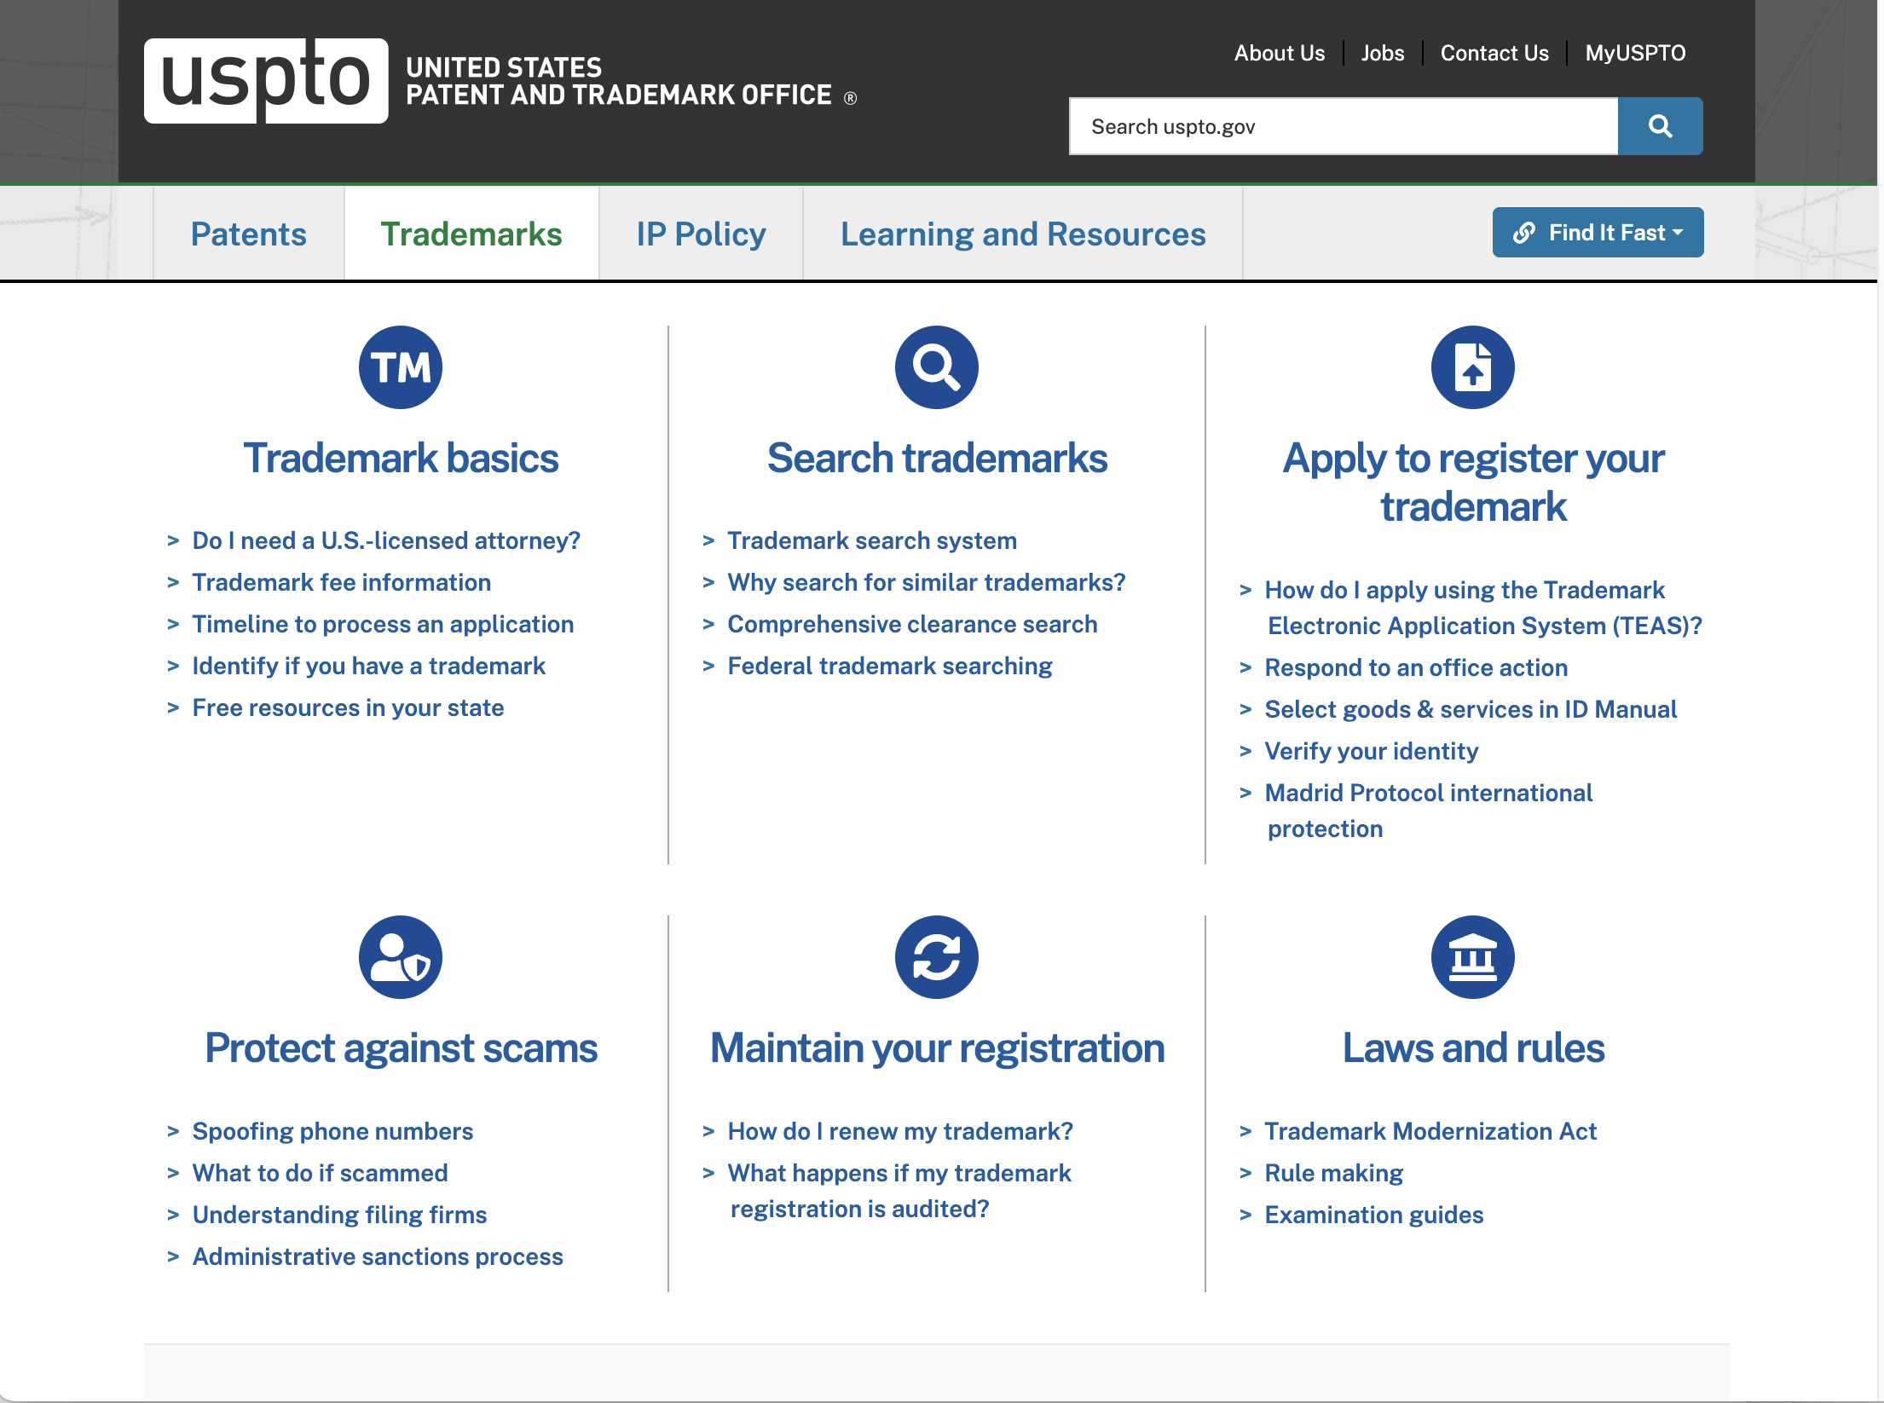
USPTO Trademark Resources
A brand new world
https://www.uspto.gov/trademarks

Slide 10
Copyright for Entrepreneurs
Miriam Lord
Associate Register of Copyrights and Director of Public Information and Education
U.S. Copyright Office
AIPLA-USPTO WE Series
March 20, 2024

Slide 11
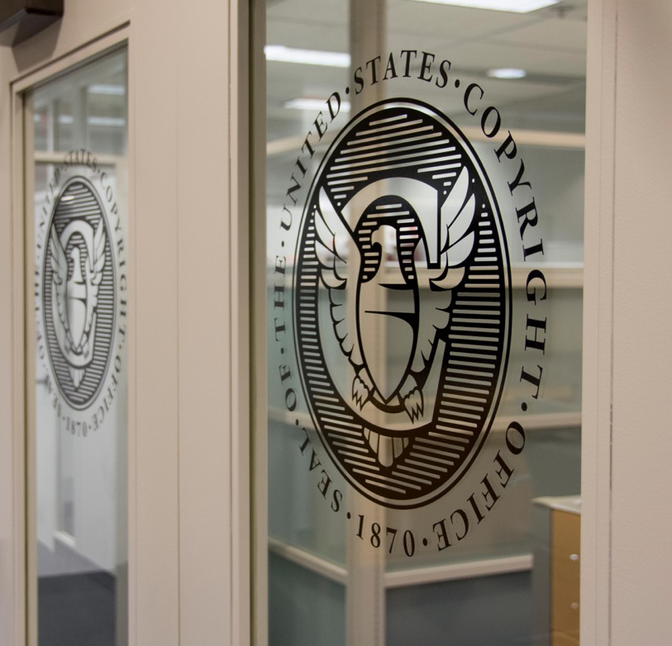
ABOUT THE COPYRIGHT OFFICE
Founded in 1870, in the Library of Congress
Administers U.S. copyright law
www.copyright.gov

Slide 12
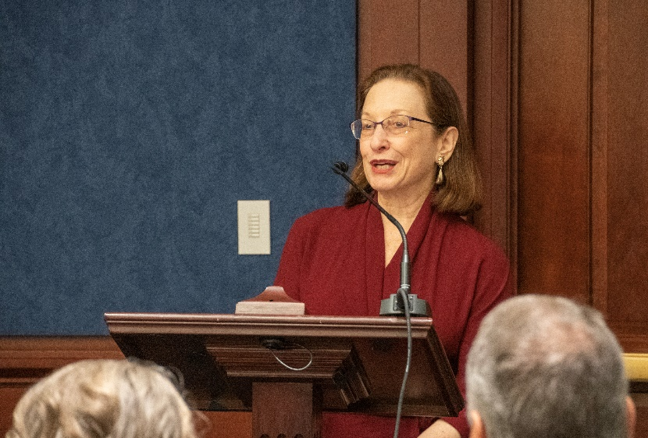
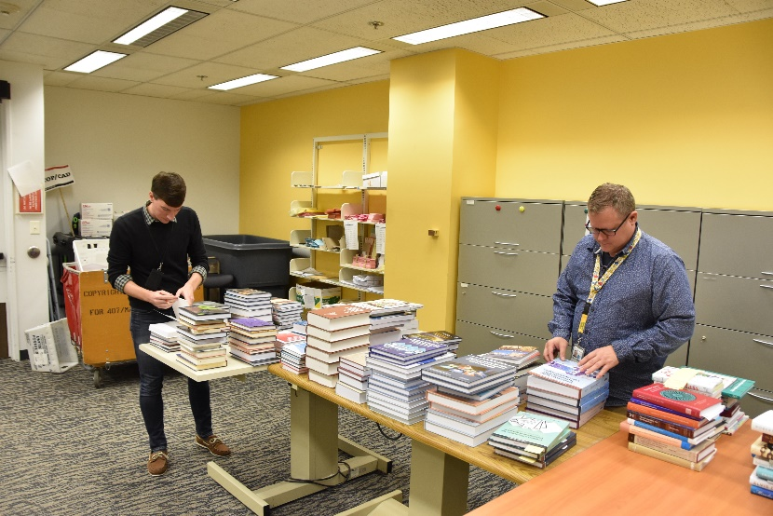
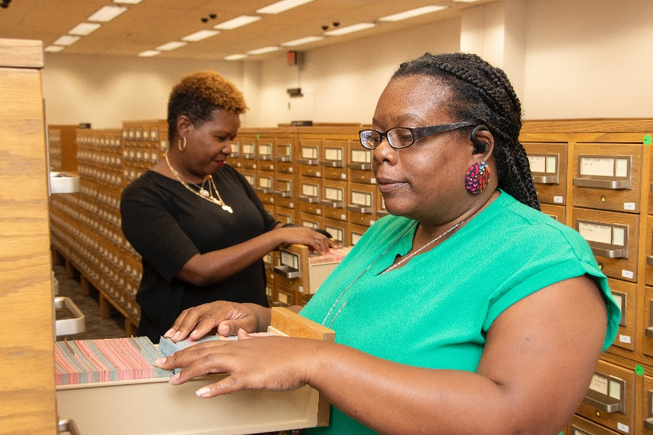
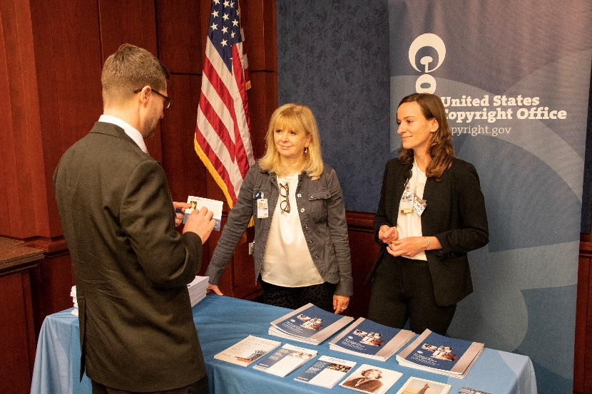
THE COPYRIGHT OFFICE TODAY
Creates/implements regulations
Makes/maintains public records
Advises Congress
Provides information to the public

Slide 13
TYPES OF INTELLECTUAL PROPERTY
Trademark
Trademarks identify the source of goods or services.
Patent
Patents protect new, inventive ideas.
Copyright protects creative expression fixed in a tangible form.
Copyright

Slide 14

WHAT IS COPYRIGHT?
Federal Law (Copyright Act, Title 17)
  Copyright protection subsists… in original works of authorship fixed in any tangible medium of expression…
  Key points:
  must be an “original”
  “work of authorship”
that is
“fixed in a tangible medium of expression”
COPYRIGHT

Slide 15
WHAT ARE “WORKS OF AUTHORSHIP”?
Literary works
Musical works including accompanying lyrics
Dramatic works
Pantomimes and choreographic works
Pictorial, graphic, and sculptural works
Motion pictures and other audiovisual works
Sound recordings
Architectural works
COPYRIGHT
Notes:
Starting with works of authorship, this slide shows you a list of copyrightable subject matter. Basically, this list includes the types of works that can be protected by copyright.
Literary works (books, poems, source code for CPs)
Musical works, including any accompanying words (songs in composition form [written music] and lyrics)
Dramatic works, including any accompanying music (plays, operas)
Pantomimes and choreography
Pictorial, graphic, and sculptural works (in different colored font because they’re the ones you’re probably most interested in – paintings, photos, sculptures, fabric, wallpaper and jewelry designs, etc)
Motion pictures and other audiovisual works (also in special font because we hear many of you create videos! This category also incl. tv shows, video games)
Sound recordings (the recording of sound including songs, audio books, podcasts, and more)
Architectural works, the design of a building including drawings and plans

Slide 16
WHAT ARE NOT “WORKS”?
Ideas
Procedures
Processes
Systems
COPYRIGHT
Methods of Operation
Concepts
Principles
Discoveries
Notes:
While we just saw that Copyright protects a wide variety of works that span many categories, there’s some material that just falls outside copyright protection. This material includes:
ideas, procedures, processes, systems, methods of operation, concepts, principles, and discoveries.
Some of these might sound familiar – when I talked briefly about patents, you might remember hearing some of this material such as processes and system. But even patent law doesn’t protect the idea alone

Slide 17
WORKS MUST BE “ORIGINAL”– INDEPENDENT & CREATIVE
“Independently created” (it was not copied from somewhere else)
It is “creative”
  The bar is a low – you only need a “spark” of creativity
  But there is a bar
    The building blocks of creativity are not copyrightable.
Effort, novelty, attractiveness, symbolism, or author intent
do not matter
Notes:
The other rqmt for originality, creativity, requires that the work contain at least a small amount of creative expression – and while the bar is low, there is a bar.
examples of works that do not meet the requirements for originality, because they are not creative enough, include:
Facts/data
Word and short phrases, such as names, titles, and slogans and lists of ingredients (those are just words and short phrases after all)
Familiar symbols and designs as well as simple geometric shapes
These are the building blocks of creativity and what that means is that we don’t want others to be prohibited from using them to create their own art – without these elements, people would experience obstacles to making and creating more art. So no one can hold the copyright on a single word or a single shape.
Last point on copyright here is that what you create doesn’t need to be innovative or presented in a particularly surprising way but does have to be more than mechanical, routine, typical, or inevitable. What’s not considered when evaluating whether something is protected by copyright is the effort put into making the work, the value that the work may possess (commercial success or popularity), the attractiveness or quality of the work or the symbolic meaning or impression that the work is intended to portray or impart (meaning the author’s intent or inspiration). Why? These are all subjective considerations that cannot be determined merely by viewing, reading or hearing a work and are subject to great variation from person to person. What I find to be beautiful artwork, Laura might not!

Slide 18
WHAT IS NOT PROTECTED? — CONTINUED
Familiar symbols & designs
Cannot exclude others from using letters, symbols, common patterns, stars, crescent moons, tear drops, etc.
Color
Color alone is not protected by copyright
Common geometric shapes are not protected by copyright – could include straight or curved lines, circles, triangles, cubes, hexagons, etc.
Basic shapes

Slide 19

WORKS MUST BE “FIXED”
“Fixed” means recorded in some manner (i.e. written down or drawn) and for a long enough period of time that it can be perceived, reproduced, or communicated.
Most works are fixed!
Key point:
Copyright protection begins automatically when the work is fixed.
Photo credit:
Zadorozhnyi Viktor / shutterstock.com

Slide 20
WHO IS A COPYRIGHT OWNER?
To be an owner, you must:
Be the author of the work
  The work’s creator, OR
  For a work made for hire, the employer or commissioning party
ARE YOU AN OWNER?
Yes! Have you painted, drawn, or sketched artwork? Or taken a photograph?
Congratulations, you are a copyright owner.
You are all copyright owners!

Slide 21
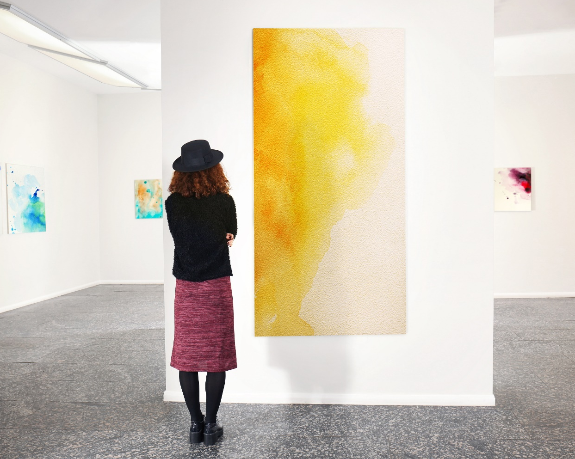
WHAT DOES IT MEAN TO BE A COPYRIGHT OWNER?
Make copies
Prepare “derivative works” based upon the copyright-protected work
Distribute to the public
Publicly perform (certain types of works)
Publicly display
Photo credit: Africa Studio / shutterstock.com
Violation of any of these rights = copyright infringement!
Notes:
Example: you decide to have your sculpture displayed at a gallery
These rights are yours as the copyright owner, so if anyone else who doesn’t own the copyright does one of these things with your work without asking permission, it could be illegal – we call that copyright infringement.

Slide 22
WHAT IF YOU’RE NOT THE COPYRIGHT OWNER?
You can get a license or use the Copyright Act’s exceptions or limitations
Copyright Act’s exceptions and limitations:
Fair Use
First Sale
Libraries and Archives
The public domain!
Expired works
Works not meeting requirements for copyright

Slide 23
HOW LONG DOES COPYRIGHT LAST?
Constitution’s Copyright Clause (Art. I, Sec. 8, Cl. 8)
To promote the progress of science …, by securing for limited times to authors … the exclusive rights to their respective writings
Generally: life of the author + 70 years

Slide 24
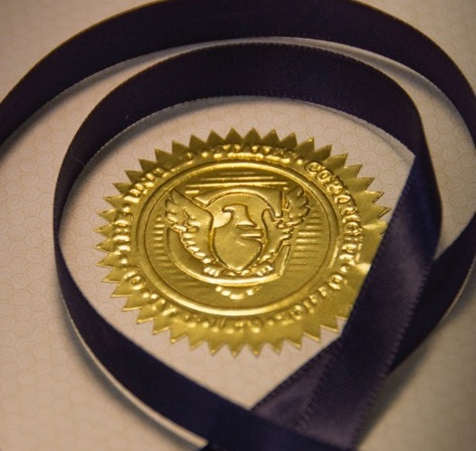
COPYRIGHT REGISTRATION
Voluntary
  Registration is not required but recommended.
One and done
  No need to “renew” or re-register
Only with the U.S. Copyright Office
  Need to register before pursuing litigation to enforce
COPYRIGHT

Slide 25

REGISTRATION BENEFITS
Helps put potential licensees in touch with you
Lets others know about your claims
Helps the public at large by contributing to the public record of creativity!
“Ticket” into court for U.S. works
Notes:
Registration also is required if you choose to file a lawsuit in court claiming copyright infringement of your work.

Slide 26
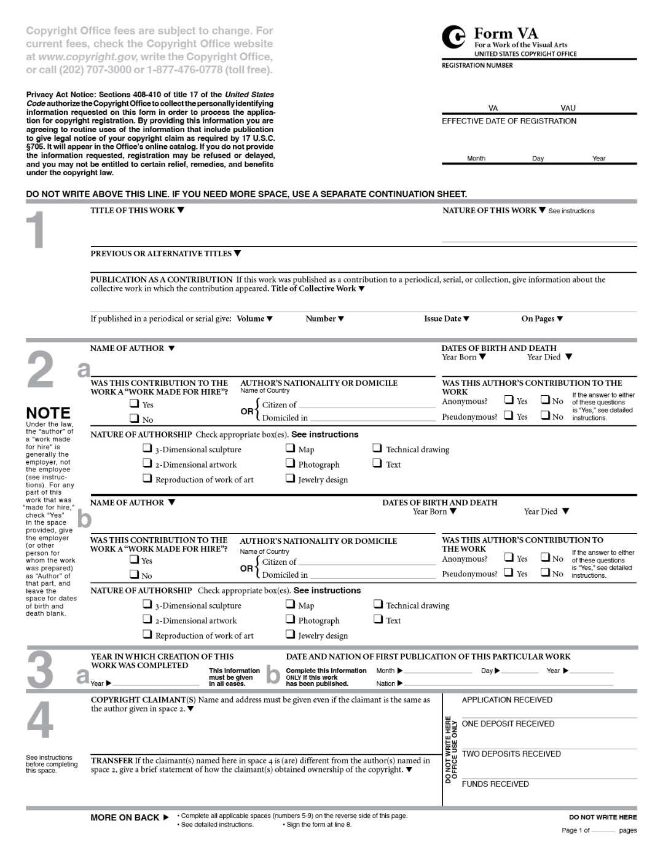
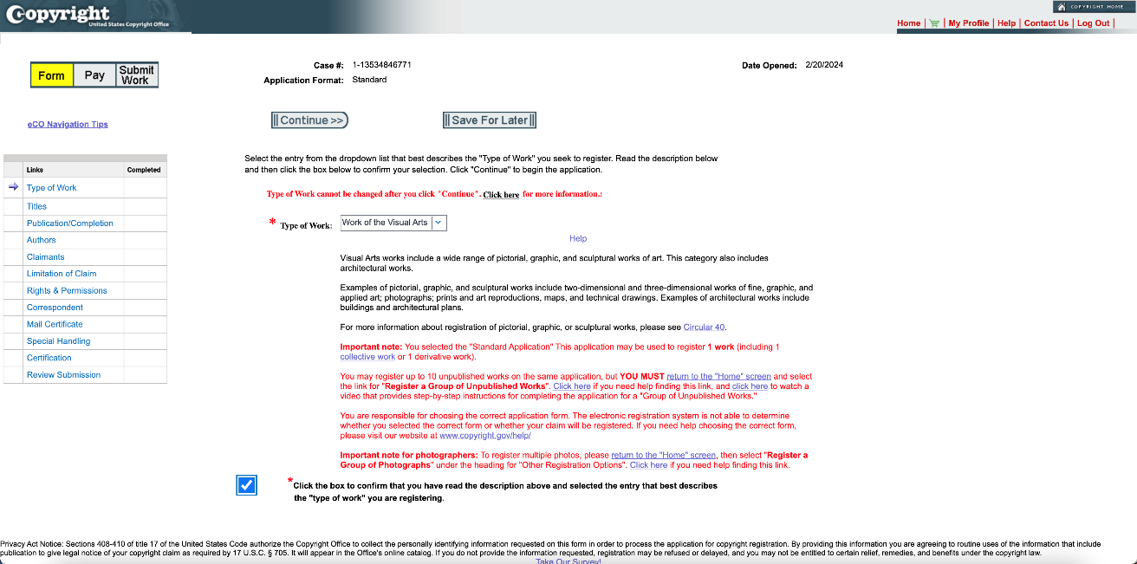
WHAT DO I NEED TO HAVE TO REGISTER?
Completed Application
Different types based on the type and number of works
Deposit
The work itself or a copy
of the work
Fee
Depends on type of work
and how many you want
to register
COPYRIGHT
COPYRIGHT
PATENT
TRADEMARK

Slide 27

MANY OPTIONS FOR REGISTRATION
Register one work at a time
Online applications ($45 or $65 eCO)
Paper application ($125 Form TX)
Group registrations options available online for:
Unpublished works ($85)
Unpublished photographs ($55)
Published photographs ($55)
Contributions to periodicals ($85)
Short online literary works ($65)
COPYRIGHT
COPYRIGHT
PATENT
Photo credit: Krakenimages / shutterstock.com
Notes:
Back to your options for registration.
The standard registration application allows you to register one work at a time. And the online applications are less expensive than the paper forms.
The Office has group options for registration as well, which allow you to register multiple works for one fee. But you can only use our online system to submit those. Though you can request an accommodation from the office if you need to use a paper form.
Unpublished works covers general works like drawings and paintings. When we say unpublished we mean that the no copies of the work have been distributed to the public and no copies have been offered to a group for further distribution, public performance, or public display.
Unpublished and published photographs is a category unique to photos. You can submit up to 750 unpublished photos for registration. When we say “published photograph” we mean that a copy of the photo was distributed to the public or copies were offered to a group of people for distribution or public display.
Contributions to periodicals, such as a photo published in a magazine, and short online literary works, like social media posts, also have group registration options.
AND coming soon the Office is planning a group registration option for 2D artworks including paintings, illustrations, sketches, collages, cartoons,
character artwork, textile designs, etc. The Office is proposing that up to 10 works can be included in each submission. So stay tuned for more on when that option might become available!

Slide 28
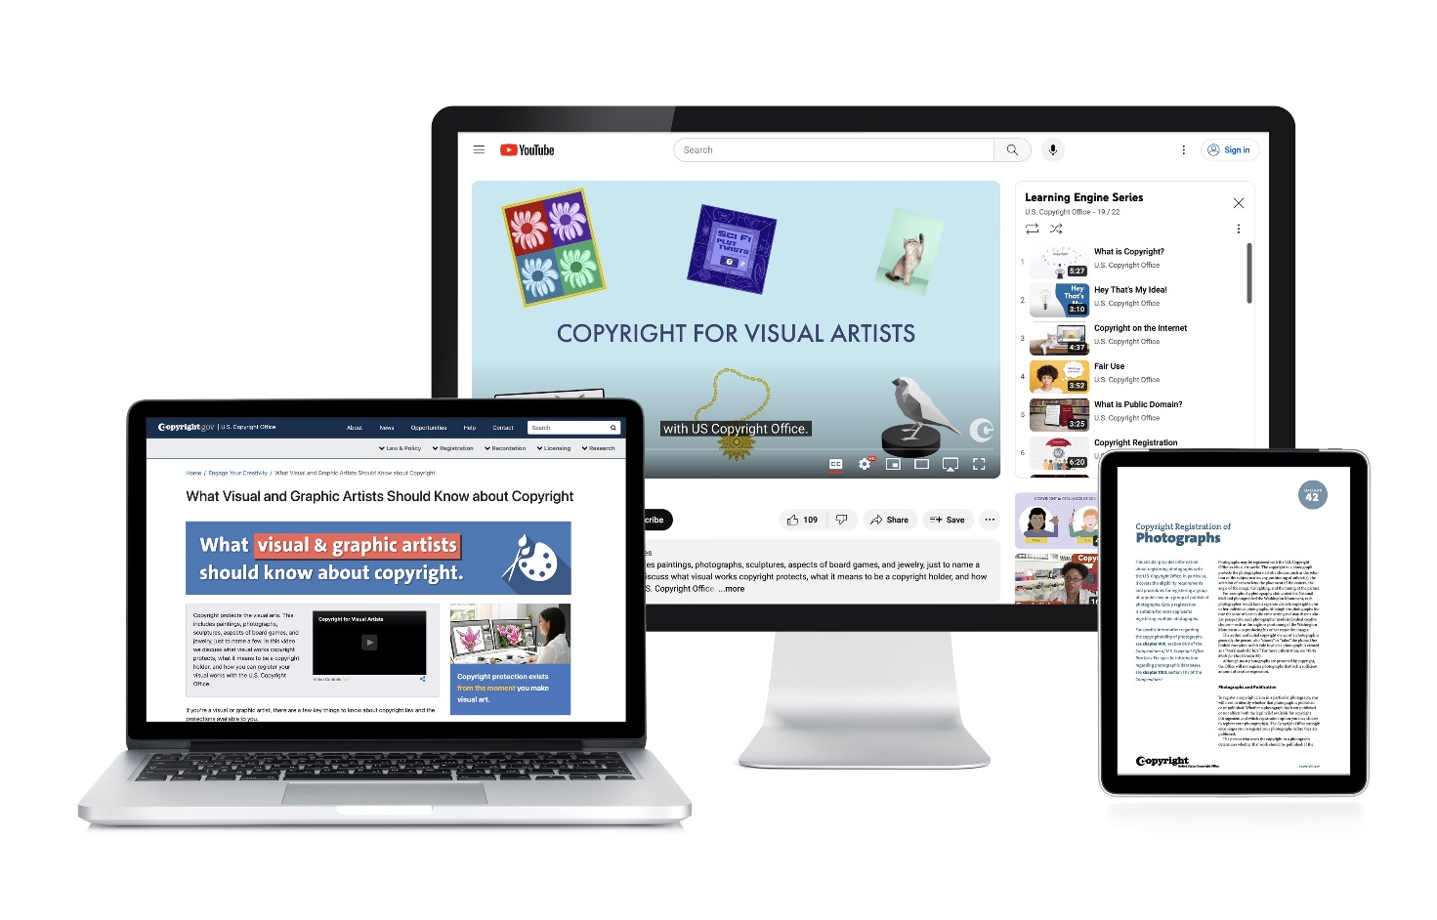





CONNECT WITH US
Subscribe to our NewsNet, blog, events and other updates at copyright.gov/subscribe

Slide 29
Questions?

